Slide 1
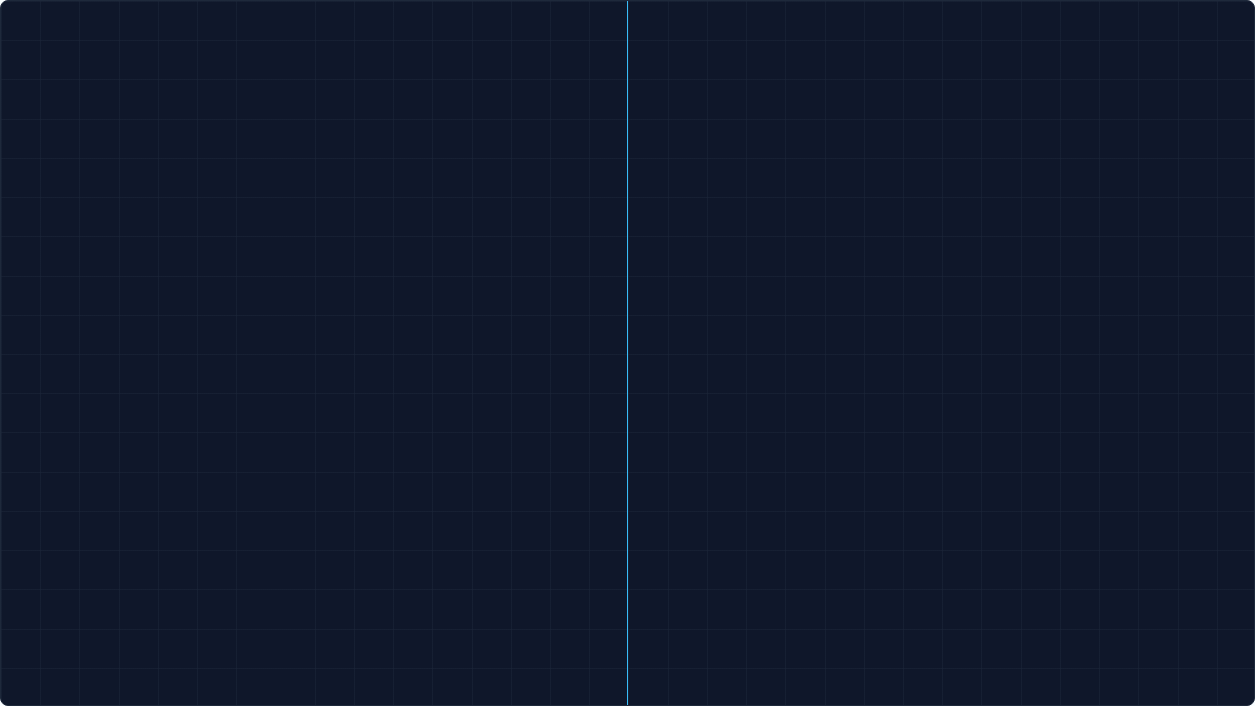
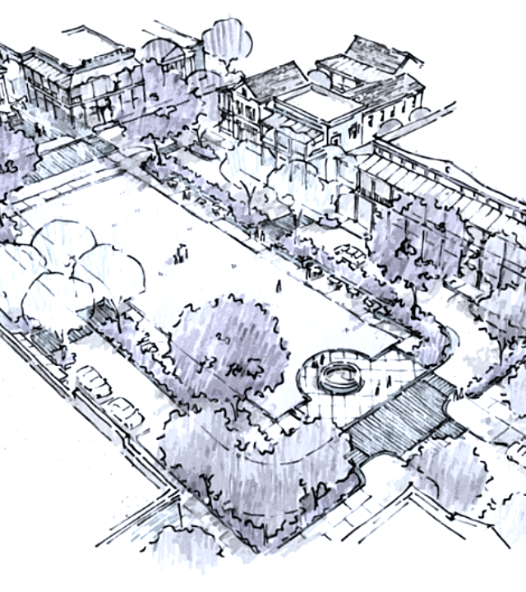

THEATRE SQUARE UNCOVERED
// CODEFORCES BETA ROUND 1 - PROBLEM 1A
Blueprint Specs
n (Length): 1 ≤ n ≤ 10^9
m (Width): 1 ≤ m ≤ 10^9
a (Tile): 1 ≤ a ≤ 10^9
Before we code, we must understand the scale. A billion meters is roughly 25 times around the Earth. We cannot count this manually.

Slide 2
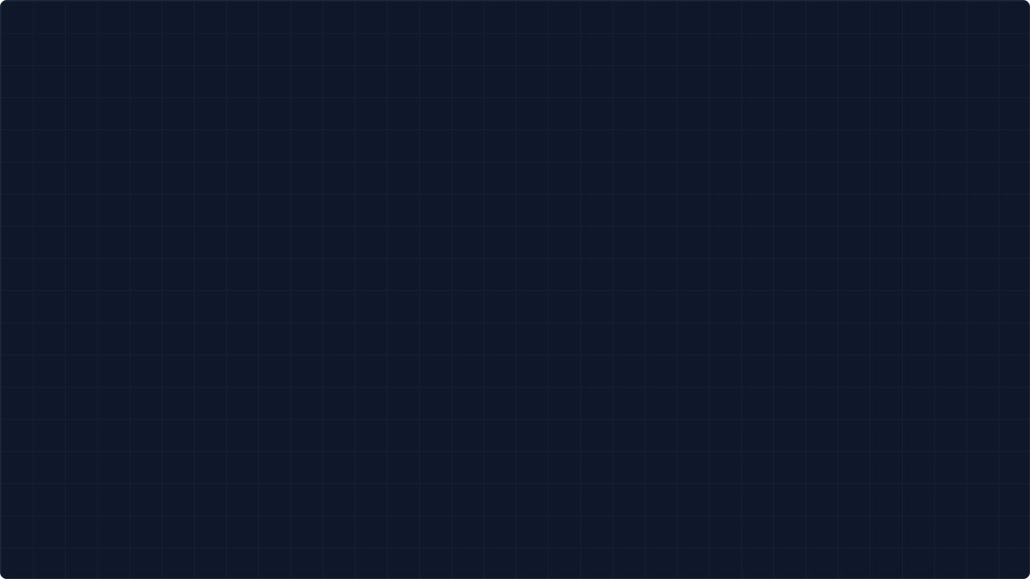


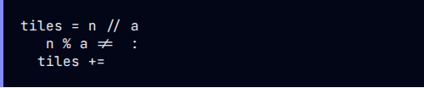
METHOD 1: THE INTUITIVE CHECK
Thinking Process
Analysis
1. Divide the total length by the tile size to get full tiles.
Pros: Very easy to understand and debug. Reflects human logic perfectly.
2. Check if there is any space left over (remainder).
Cons: Verbose. Requires branching (if-statements) which can be slightly slower in massive loops (though negligible here).
3. If remainder > 0, add one more tile.
if
0
1

Slide 3
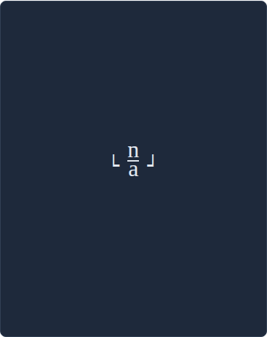
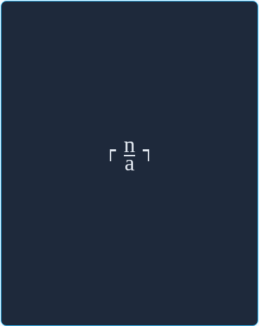




METHOD 2: THE MATHEMATICIAN
The Floor
The Ceiling
The Implementation
math.ceil(n / a)
// Warning: Uses floats. Precision risk at 10^18.
Rounds down. Good for cutting, bad for covering.
Rounds up. The correct mathematical model for "coverage".

Slide 4


METHOD 3: INTEGER ELEGANCE
Can we perform a "ceiling" operation using only integers? Yes.
Why it Works
By adding a - 1, we push the numerator just high enough that:
The Magic Formula
•
If n is a multiple of a, it changes nothing.
•
If n has a remainder (even 1), it pushes it to the next multiple.
(n + a - 1) // a
# Example: n=6, a=4
2
# Correct

Slide 5
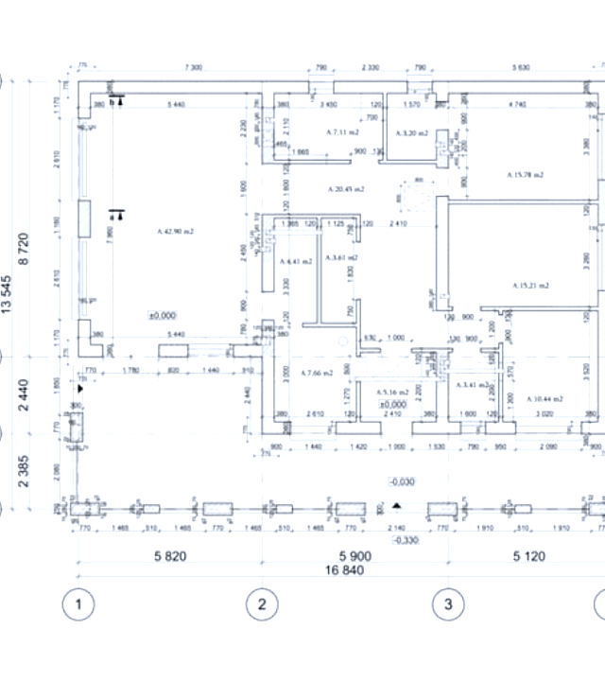

THE 2D EXPANSION
Why Multiply?
A common mistake is adding the results: tiles_n + tiles_m. This calculates a perimeter (an "L" shape).
We are building a grid. For every row of tiles along the width, we need a full column of tiles along the length.

Slide 6
STRESS TESTING CONSTRAINTS
Method | Complexity | Precision Safety | Verdict
Method 1 (If/Else) | Low (Branching) | High (Integer) | Reliable but Verbose
Method 2 (Math.ceil) | Medium (Float Ops) | Risky (Float limits) | Avoid for 10^18
Method 3 (Integer Formula) | Lowest (Pure Math) | High (Integer) | Production Ready 🏆
*Note: In C++ or Java, Method 2 can fail large test cases due to floating point precision errors. Python handles large integers automatically, but the logic remains best practice.

Slide 7




EVOLUTION OF A SOLUTION
Phase 1
Phase 2
Phase 3
Phase 4
Understand
Solve 1D
Solve 2D
Optimize
Constraints & Physical Reality
Ceiling Division Logic
Area Multiplication
Integer Math & Data Types

Slide 8



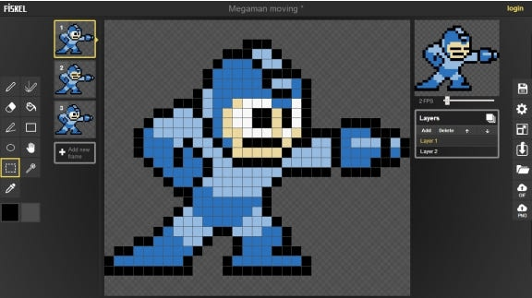
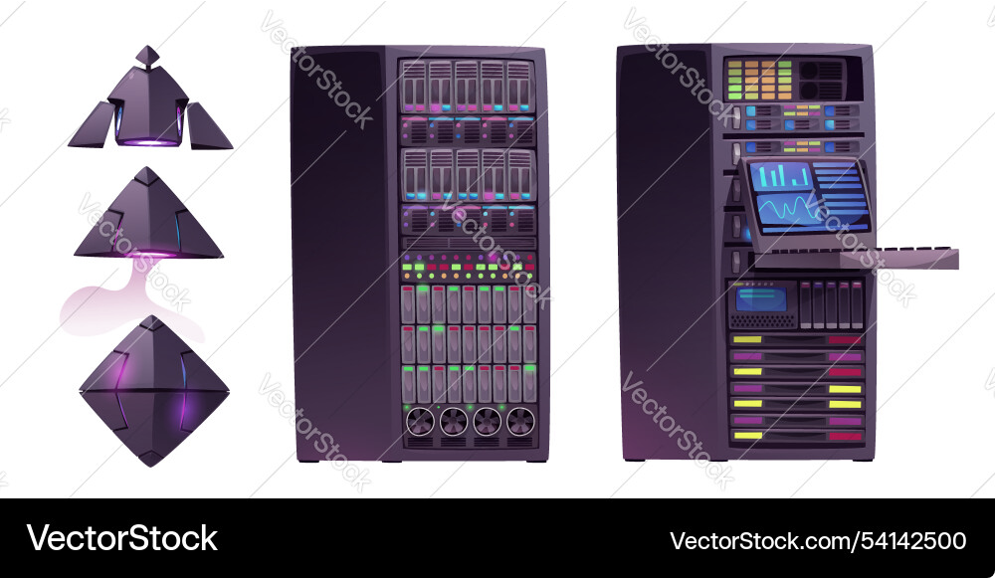
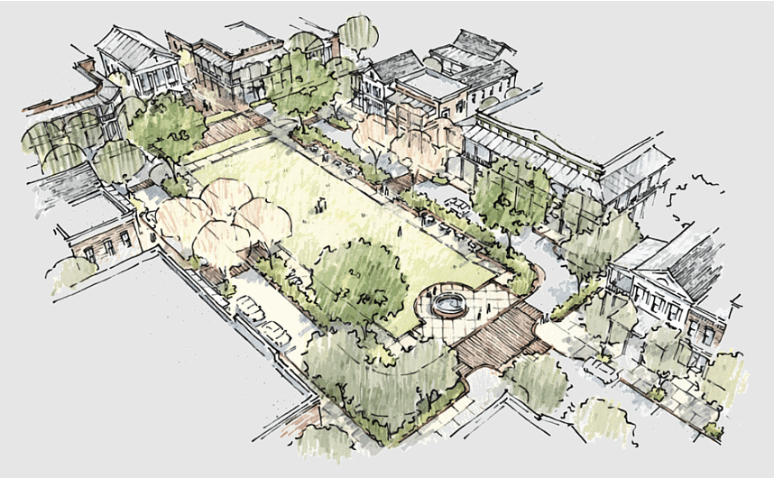
TRANSFERABLE SKILLS
Game Dev
Systems Arch
Logistics
Tile maps, sprite sheets, and collision detection grids all use this ceiling division logic.
Memory paging and allocating server instances often require rounding up to the nearest block size.
Shipping container optimization and material ordering: You can't order 4.5 trucks.

Slide 9



CODE DOJO
main.py test.py
Interactive Metrics
import sys
# Read Input
n, m, a = map(int, sys.stdin.readline().split())
# The Optimized Solution
count_n = (n + a - 1) // a
count_m = (m + a - 1) // a
print(count_n * count_m)
Input:
1000000000 1000000000 1
Output:
1000000000000000000
Execution Time: 0.004ms

Slide 10





MASTERY CHALLENGE
Level 1
Level 2
Level 3
Explain "Ceiling Division" to a non-programmer using a real-world analogy.
Rewrite the solution in C++ and identify the specific data type required to prevent overflow.
What if tiles could be rotated 45 degrees? How does the geometry change?

Slide 11
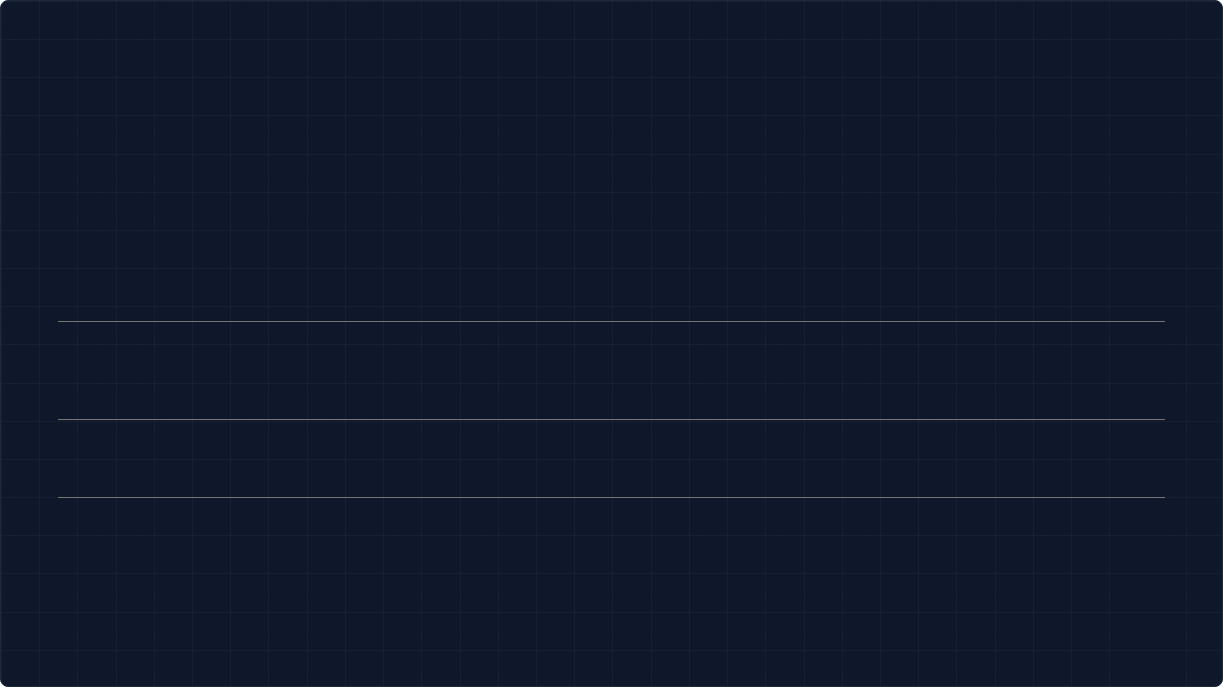




IMAGE SOURCES
https://a0.anyrgb.com/pngimg/88/34/town-square-drawing-board-suburb-neighbourhood-urban-design-village-town-residential-area-land-lot-concept.png
Source: www.anyrgb.com
https://preview.redd.it/what-are-those-numbers-and-letters-on-floor-plans-what-is-v0-xkczp2z7lml81.jpg?width=640&crop=smart&auto=webp&s=e21481612c4096865e64b40cfa0429821089c676
Source: www.reddit.com
https://miro.medium.com/1*SgnpNzwNLVKQtqOblGM9BA.jpeg
Source: medium.com
https://cdn.vectorstock.com/i/1000v/25/00/purple-server-data-center-vector-54142500.jpg
Source: www.vectorstock.com

